Slide 1
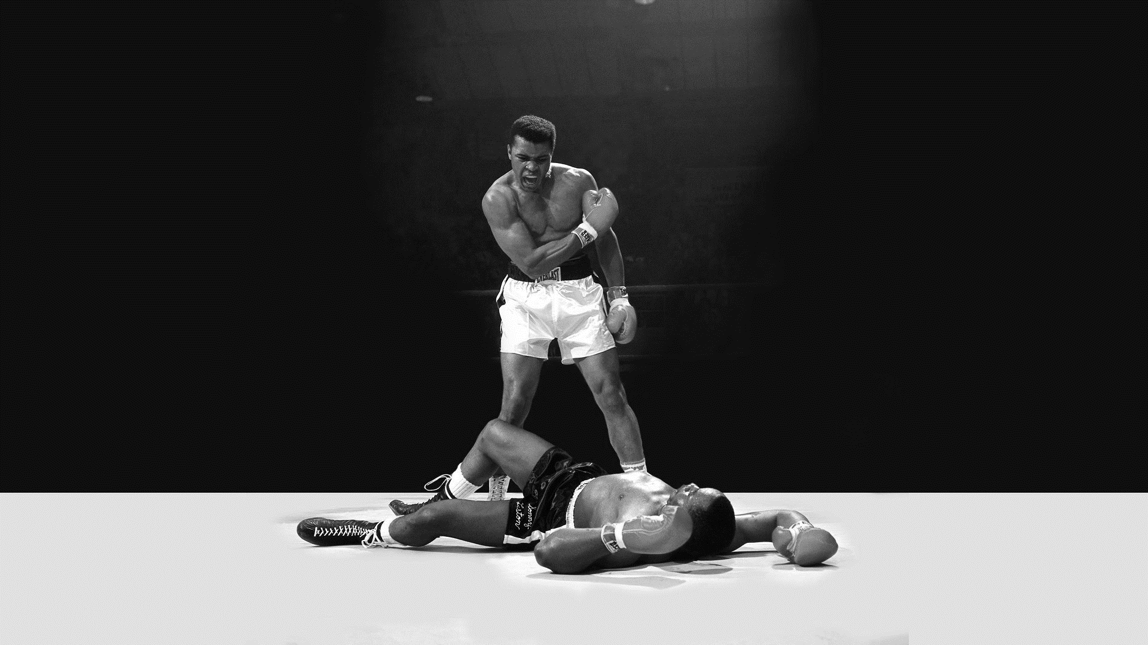
Muhammad Ali
Timeline
Student: Isaac Reyna Uresti
Teacher: Enrique Gutierrez Acosta
Group: 11

Slide 2

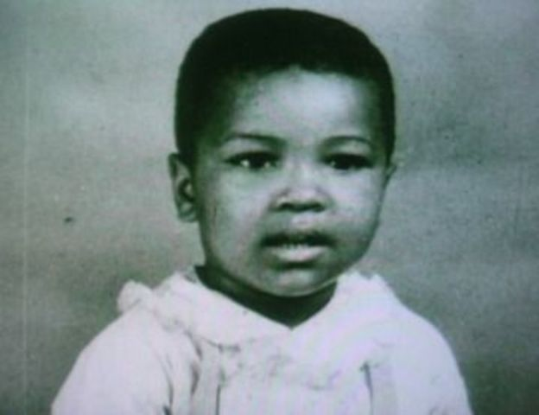
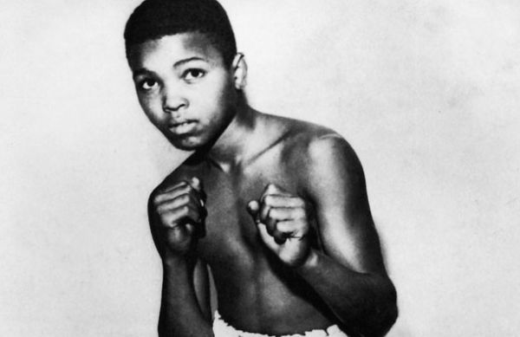
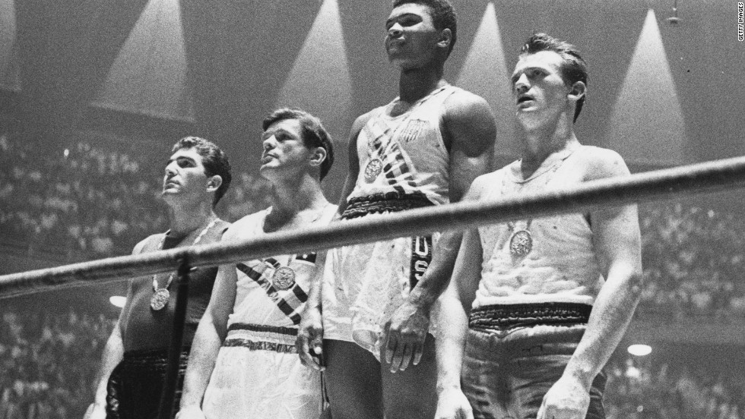
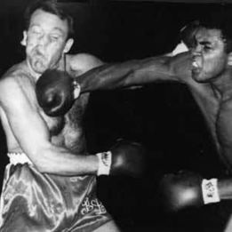
1942
Cassius Marcellus Clay Jr. was born on January 17, 1942 in Louisville, Kentucky, United States.
1954
In 1954 he began training boxing with policeman Joe Martin due to the theft of his bicycle.
1960
1960
He won the gold medal of the 1960 rome olympic games
Debuted on October 29, 1960 at Freedom Hall in Louisville defeating Tunney Hunsaker

Slide 3
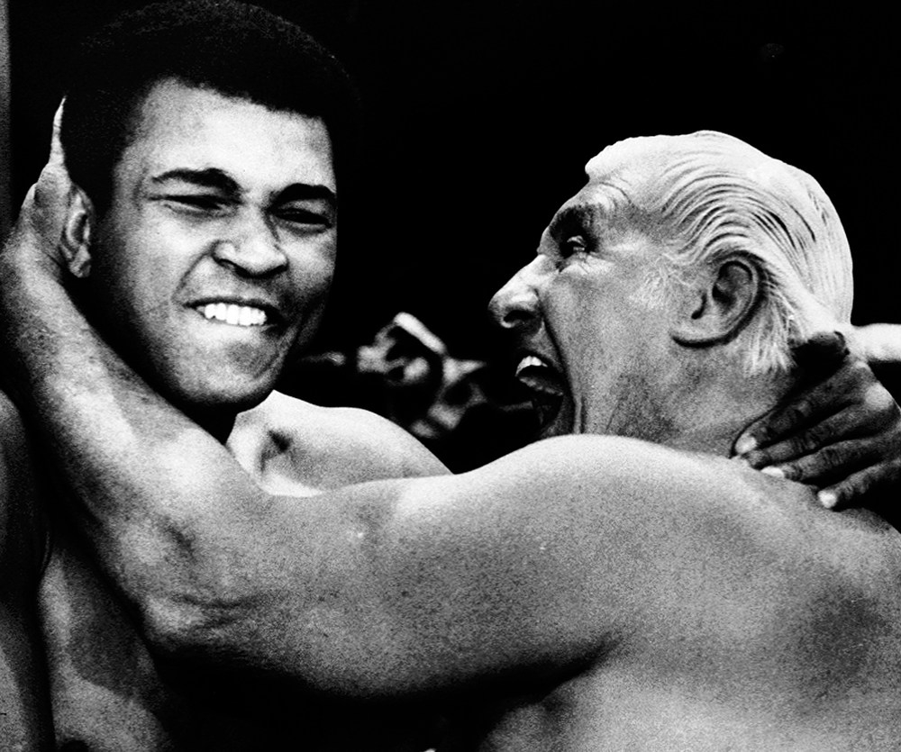
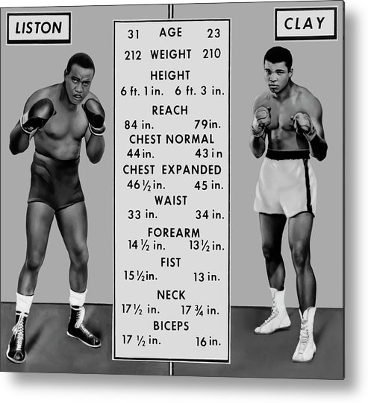
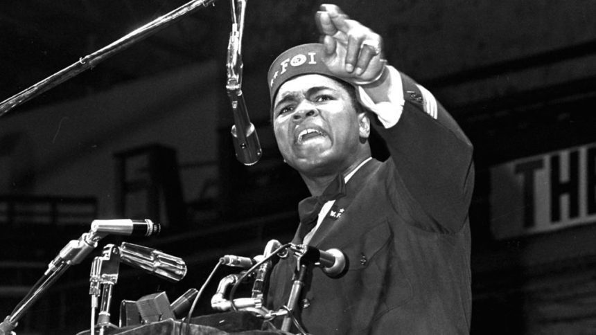
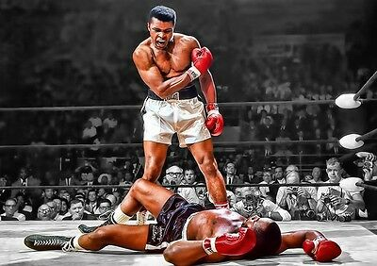
1961
In June 1961 he met professional wrestler Gorgeous George who would have a great influence on his behavior.
1964
On February 25, 1964 he defeated Sonny Liston, obtaining the world heavyweight title
1964
1965
On February 26, 1964 he converts to Islam and changes his name to Muhammad Ali
On May 25, 1965, he defeated Liston again, retaining his title.

Slide 4
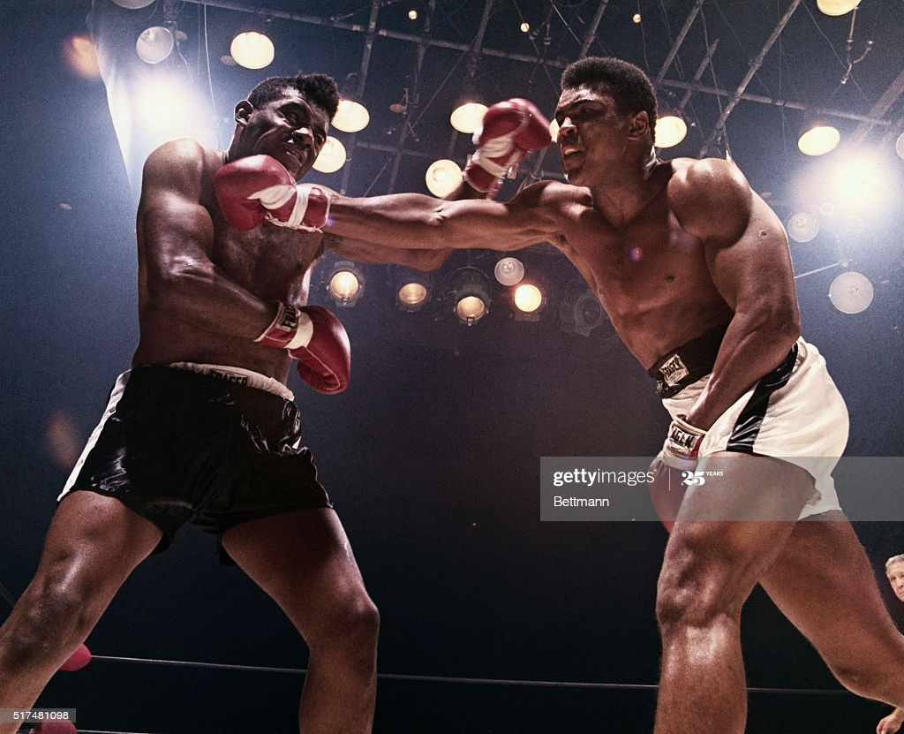
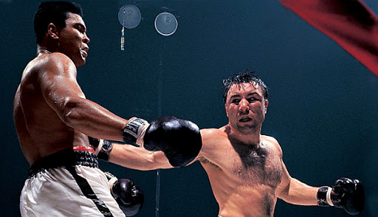
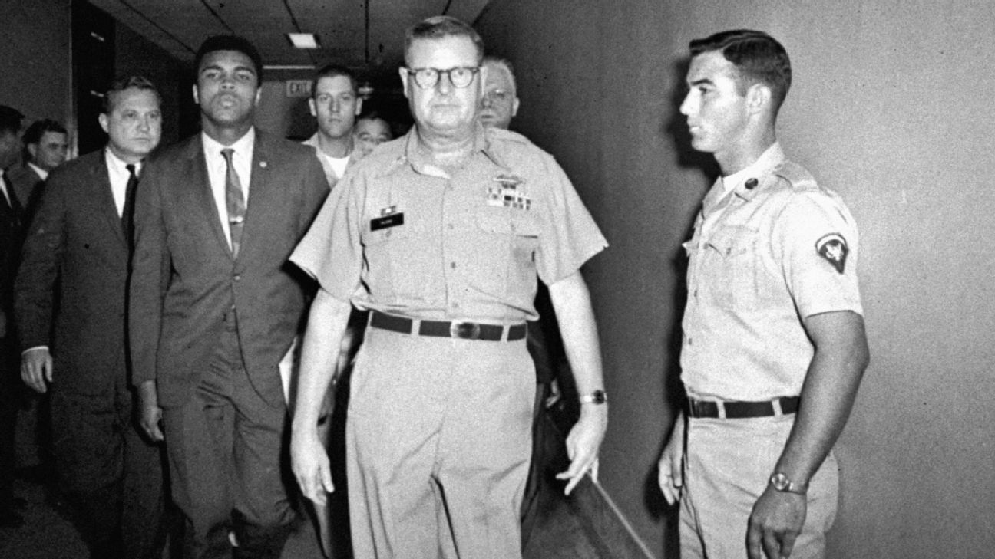
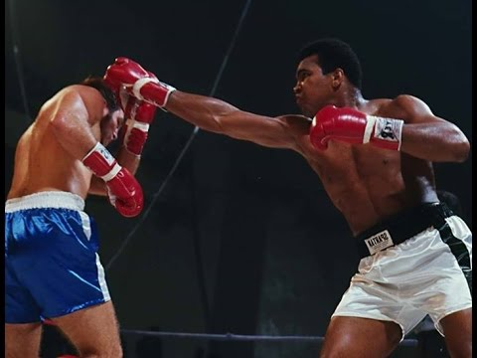
1965
On November 22, 1965 he defeated Floyd Patterson in Las Vegas
1966
On March 29, 1966 he defended his title for the third time defeating George Chuvalo
1967
1970
On April 28, 1967 Muhammad Ali refused to go to war, this resulted in his boxing title and license being withdrawn
On October 26 he makes his return to boxing facing Jerry Quarry

Slide 5
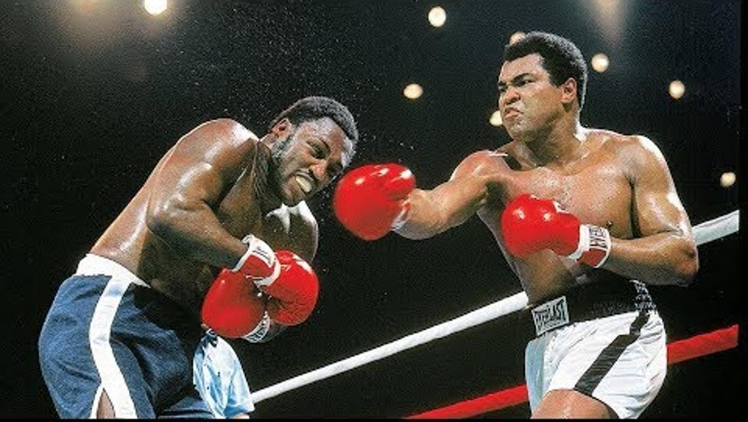
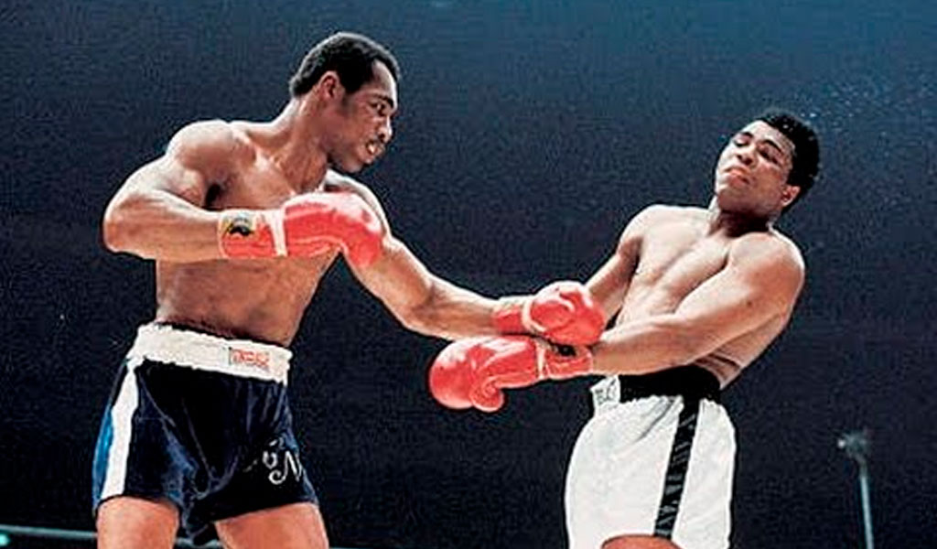
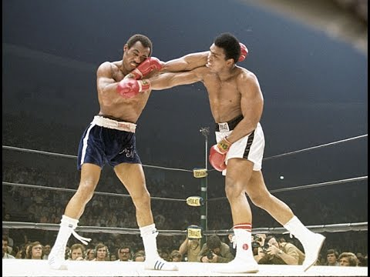
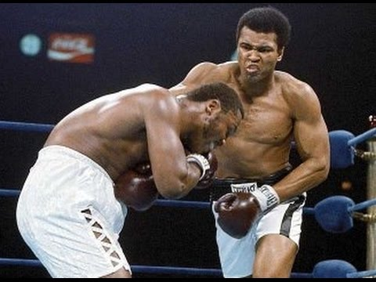
1971
1973
On March 8, 1971 he faces Joe Frazier losing his title
On March 31, 1973 he obtained his second defeat against Ken Norton
1973
1974
On September 10 he has a rematch against Ken Norton getting his title back
On January 28, 1974 he faced Joe Frazier again this time winning

Slide 6
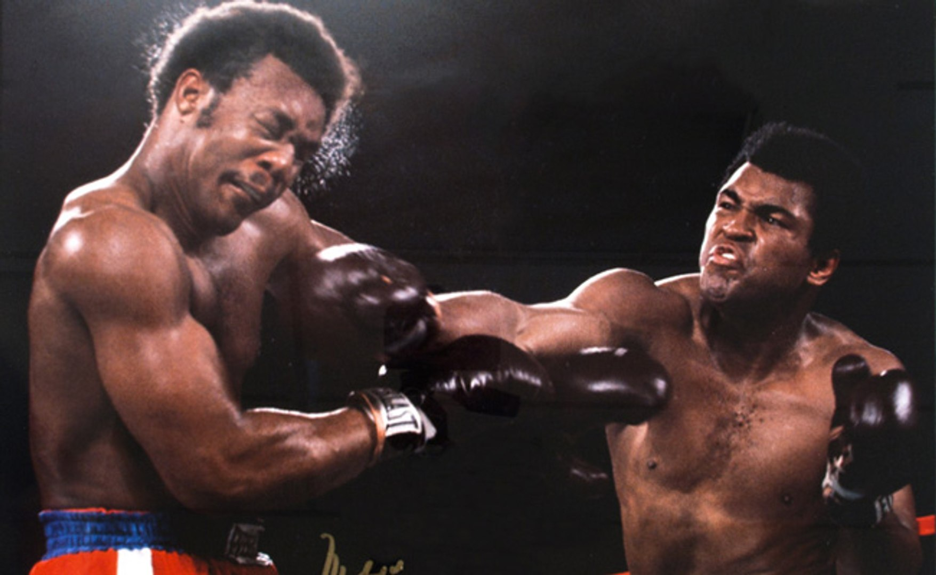
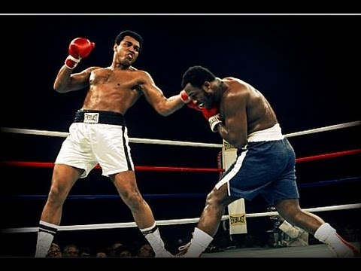
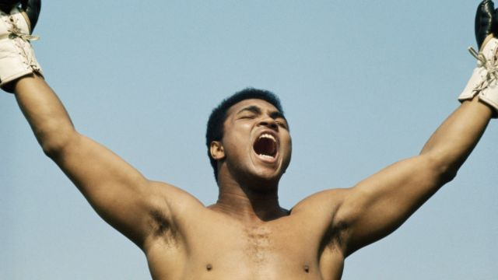
1974
1975
On October 30 he defeats George Foreman in front of 60,000 spectators
On October 1, 1975 he faced Joe Frazier for the third time
1981
On December 11, 1981, he decided to retire

Slide 7
Conclusion
Muhammad Ali is considered the greatest athlete of the 20th century, he was a fighter all his life, he became a symbol of courage in the face of adversity. Muhammad Ali proclaimed that champions are not made in gyms, they are made of something immaterial: a wish, a dream, an illusion. Muhammad Ali managed to go down in history as the greatest

Slide 8
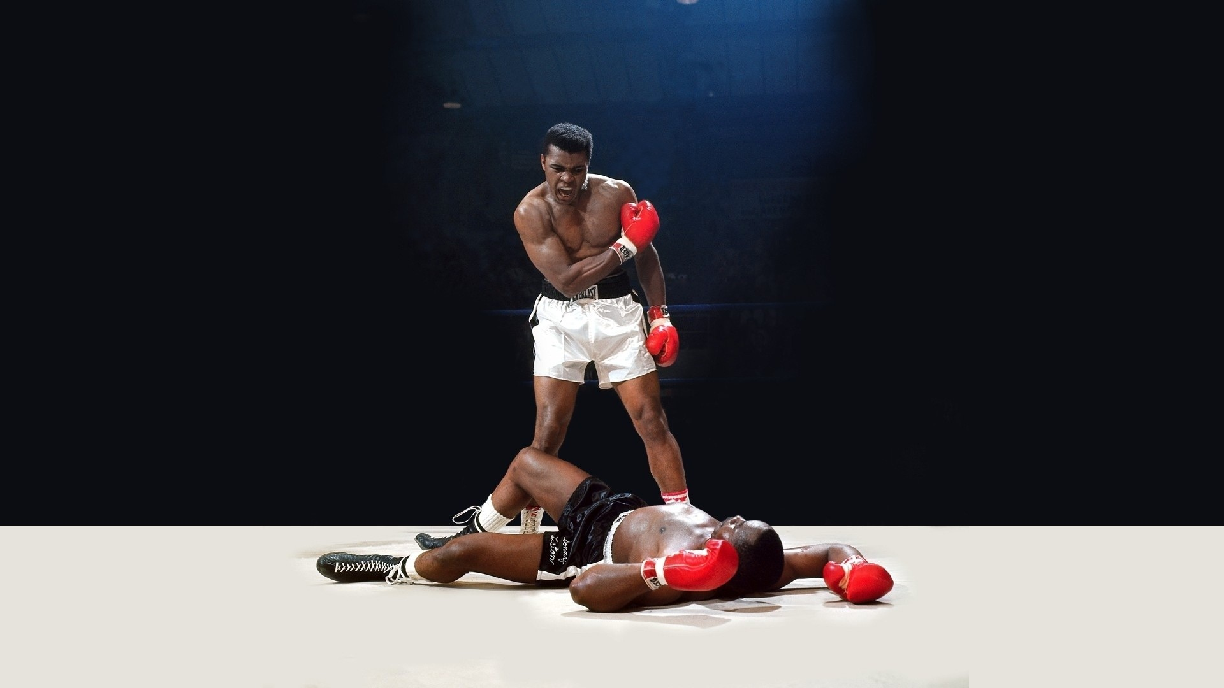

Slide 9
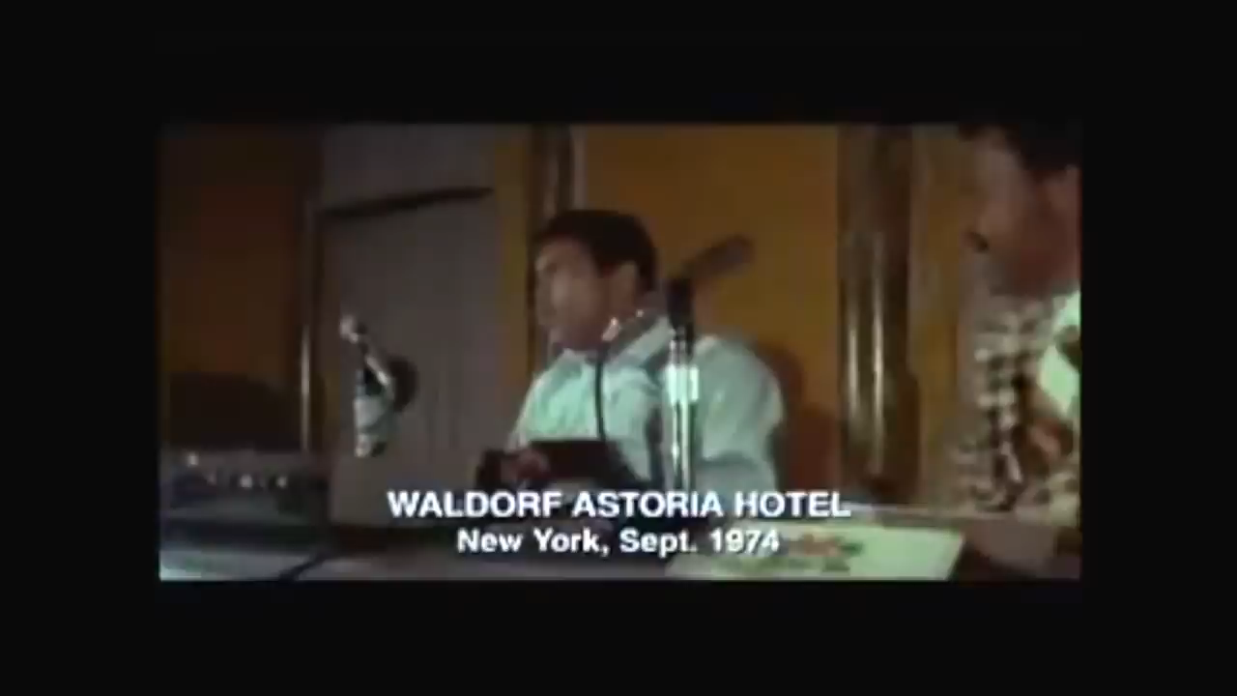

Slide 10
Bibliographic references
https://es.wikipedia.org/wiki/Muhammad_Ali#Trayectoria_en_el_boxeo
https://www.youtube.com/watch?v=P6yqVyWq6ks

